Slide 1

Chapter 1: What is the Web?
Introduction to Web Development
YNC Hacks
Software Track

Slide 2
01
02
03
04
AGENDA
05
WELCOME
HOW THE WEB WORKS
SETTING UP
FILE MANAGEMENT
BASIC HTML

Slide 3
Welcome
Welcome
How the Web Works
Setting Up
File Management
Basic HTML
Goals for the training programme
Learn basic web development skills
Write clean code
Contribute to YNC Hacks projects

Slide 4
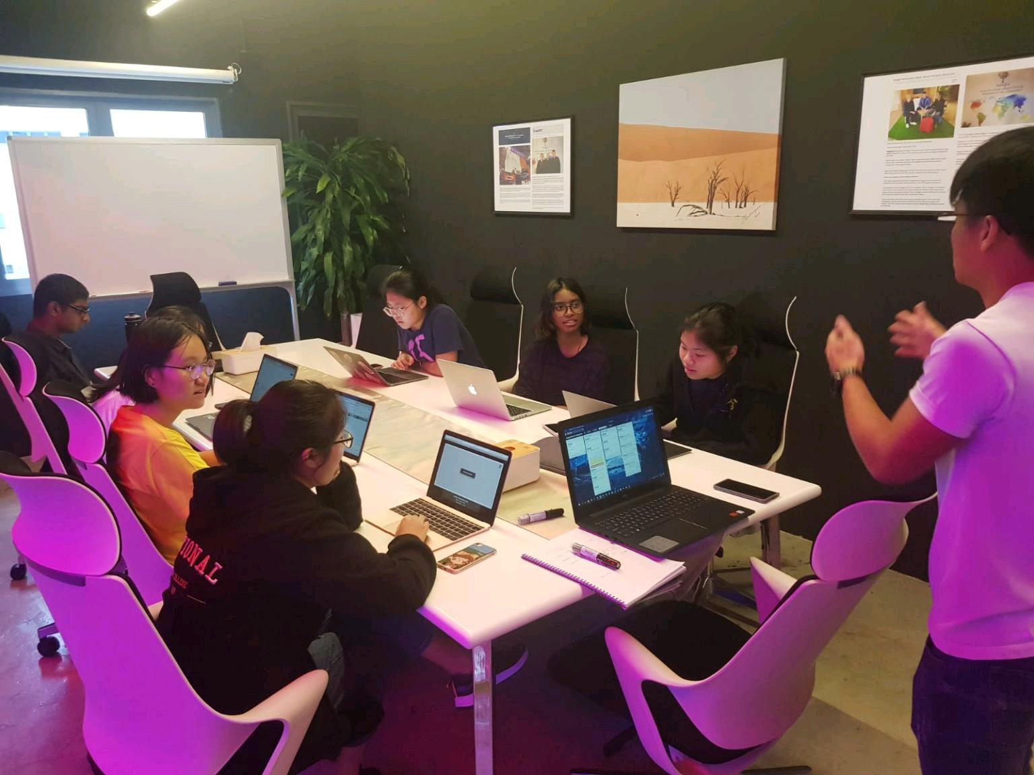
About Me
Welcome
How the Web Works
Setting Up
File Management
Basic HTML
Worked as a Software Engineer before college
Was a TA at NTU for a web development module
Experience in building web applications
Preferred Stack: React TypeScript + Django REST Framework + MySQL
Notable Projects: leonardtng.com, codecache.io

Slide 5

How the Web Works
Welcome
How the Web Works
Setting Up
File Management
Basic HTML

Slide 6
CLIENTS AND SERVERS
Welcome
How the Web Works
Setting Up
File Management
Basic HTML
CLIENT
REQUESTS/
RESPONSES
SERVER
Web user’s interface, your users/customers
(Frontend)
Communication between the client and the server
Computers that store webpages, sites, or apps
(Backend + DB)

Slide 7
What Happens?
Welcome
How the Web Works
Setting Up
File Management
Basic HTML
Browser goes to the DNS to find the real address of the server
Browser sends a HTTP request, asking for website and assets. Request is sent using TCP/IP
If server approves, it starts sending website files to the browser
Browser assembles website and displays it to you

Slide 8

DNS
Welcome
How the Web Works
Setting Up
File Management
Basic HTML
IP Addresses: eg. 104.198.120.182
DNS matches the website domains we are familiar with to their IP addresses

Slide 9
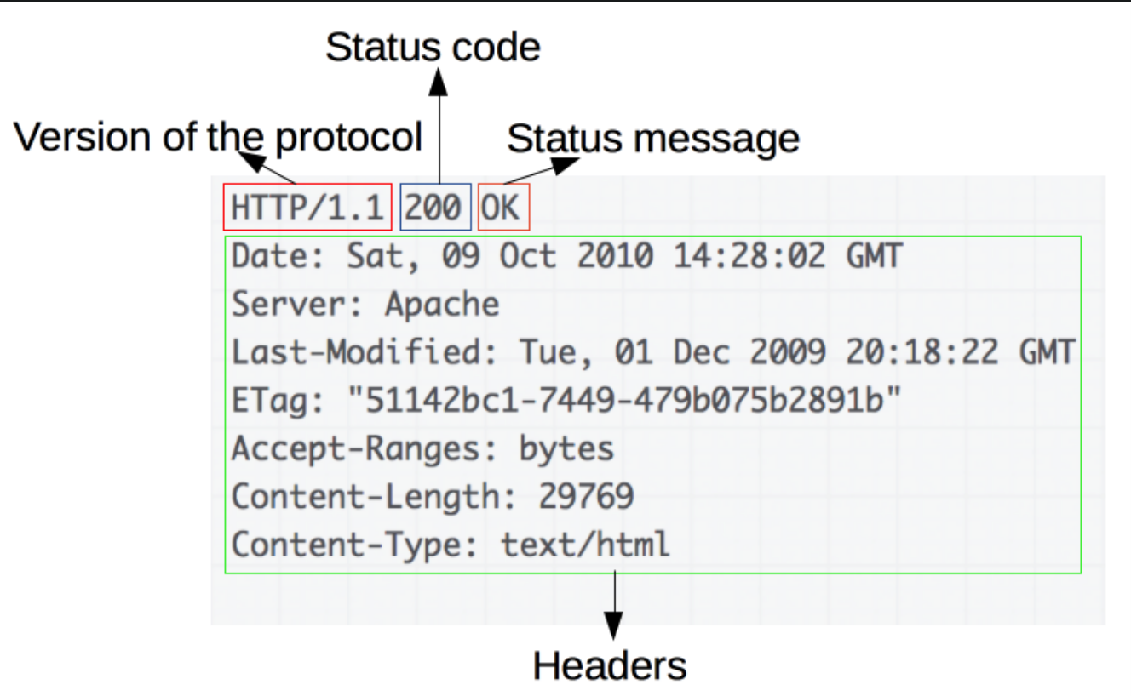
HTTP
Welcome
How the Web Works
Setting Up
File Management
Basic HTML
Stands for Hypertext Transfer Protocol
Protocol for transmitting hypermedia documents like your website’s files
Requires internet connection

Slide 10




Setting Up
Welcome
How the Web Works
Setting Up
File Management
Basic HTML
Visual Studio Code
CodeCache (Optional)
Installation: https://code.visualstudio.com/download
Create an Account:
https://codecache.io
Extensions
Live Server
HTML CSS Support

Slide 11
Introduction to Dev Tools
Welcome
How the Web Works
Setting Up
File Management
Basic HTML
Text Editors
IDEs
Versioning/Repo
VS Code, Sublime Text, Emacs, Notepad
PyCharm, R Studio, Xcode
Git, Mercurial, GitHub
Platforms
Management
Utilities
Postman, Docker, Unity
Trello, Asana
Adobe Suite, Figma, CodeCache, Slack

Slide 12
File Structure

Slide 13

Dealing with files
Welcome
How the Web Works
Setting Up
File Management
Basic HTML
HTML
Stylesheets
Contains your website’s content
Your website’s colour, fonts, etc.
Assets
Scripts
Images, icons, font files, etc.
JavaScript that adds functionality
and much more…

Slide 14


HTML
Welcome
How the Web Works
Setting Up
File Management
Basic HTML
Hypertext Markup Language
Consists of elements in the form of tags

Slide 15
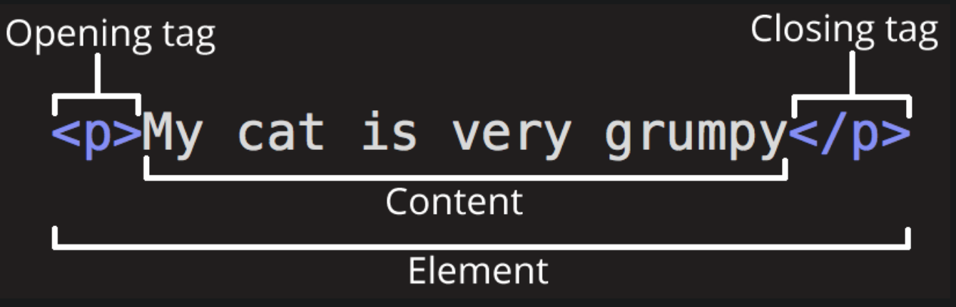
Anatomy
Welcome
How the Web Works
Setting Up
File Management
Basic HTML

Slide 16
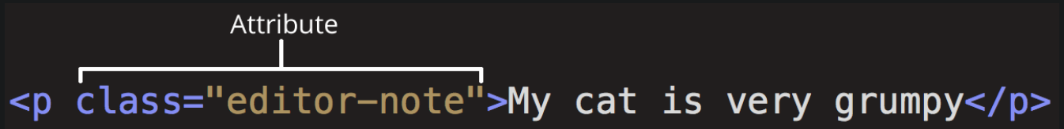
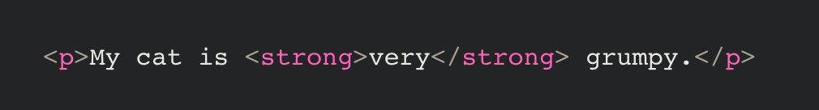
Anatomy
Welcome
How the Web Works
Setting Up
File Management
Basic HTML
Attributes
Common Opening Tags
div
ul, li
img, a
p
h1, h2, h3, etc.
style, script
Nesting

Slide 17

HTML HELLO WORLD
Welcome
How the Web Works
Setting Up
File Management
Basic HTML

Slide 18
PROJECT 1
Welcome
How the Web Works
Setting Up
File Management
Basic HTML
Create your very first HTML website!
Ideas:
A simple resume
Your most recent PPT essay (include images!)
A “bookmark” website (with links to all your favorite websites)
ANYTHING AT ALL!
Try to include:
Images, links, markup

Slide 19
PROJECT 1
Welcome
How the Web Works
Setting Up
File Management
Basic HTML
Example site! A web notice for this workshop:
http://introduction-to-web-development.s3-website-ap-southeast-1.amazonaws.com/

Slide 20
THANK YOU
Welcome
How the Web Works
Setting Up
File Management
Basic HTML
Repository: https://github.com/leonardtng/introduction-to-web-development
Do you have any questions?
Some content in these slides are adapted from developer.mozilla.org

